Slide 1
GMETS Analysis
Grounded-theory analysis of narrative evaluations
Inputs, outputs, interpretation, key takeaways, and action items
50,000 narrative rows
1,727 evaluation events
Rick Rejeleene
October 2026
Notes:
This deck summarizes the GMETS narrative-analysis pipeline and explains what each result means. The emphasis is on interpretation rather than simply presenting charts.

Slide 2
Executive summary
What the narrative data say at a high level
Learning is strongly feedback-centered
Psychological safety and supervision matter
1
2
Faculty teaching, feedback and mentorship is the most prevalent environment feature; iterative feedback and coaching is the most prevalent learning mechanism.
Psychological safety and supervision availability are among the most commonly surfaced constructs across the narrative corpus.
Development is broader than technical skill
Narratives are overwhelmingly positive
3
4
Communication/teamwork, feedback receptivity, clinical reasoning, and autonomy dominate the developmental-outcome profile.
Roughly nine in ten evaluation events carry a positive performance signal, creating a strong class imbalance for concern detection.
Feedback quality is moderate, not excellent
Data-quality rules need tightening
5
6
Specificity and actionability mostly sit around 3 out of 5, leaving room for targeted improvement in feedback-writing quality.
“No explicit feature” co-occurs with explicit categories, and taxonomy-gap outputs are dominated by missing/duplicate labels—both should be corrected before inferential use.
Notes:
The narrative corpus tells a coherent story: learning appears to be built around feedback, supervision, psychological safety, and structured teaching. Developmental outcomes are not just technical; communication, self-directed learning, reasoning, and autonomy are prominent. The results are descriptive and should not be treated as causal without multivariable modeling and validation.

Slide 3
What went into the analysis—and what came out
Unit of interpretation: evaluation events aggregated from narrative rows
INPUT
CODING
AGGREGATION
OUTPUTS
50,000 narrative rows
Structured scores
Year / evaluation type / evaluatee metadata
GPT-5 nano multi-label classification
Environment
Mechanism
Development
Performance signal
Confidence
Rows consolidated into 1,727 evaluation events
Event-level prevalence and co-occurrence
Prevalence
Score associations
Co-occurrence
Feedback quality
Time trends
Repeated-score change
Taxonomy gaps
IMPORTANT READING RULE
ASSOCIATION ≠ CAUSATION
QUALITY FLAG
These are multi-label outputs. One evaluation event can contain several categories, so percentages can sum to more than 100%.
Odds ratios describe whether a coded category is more common in high- versus low-score evaluations. They do not show that the category caused the score.
“No explicit feature” should normally be mutually exclusive with explicit environment labels. Its high co-occurrence indicates a coding-rule issue to fix.
Notes:
The analysis starts with narrative rows plus structured scores and metadata. The LLM produces multi-label codes. Those row-level labels are aggregated at the evaluation-event level for prevalence, associations, and trend analyses. Because categories are multi-label, percentages across bars are not expected to add to 100%.

Slide 4
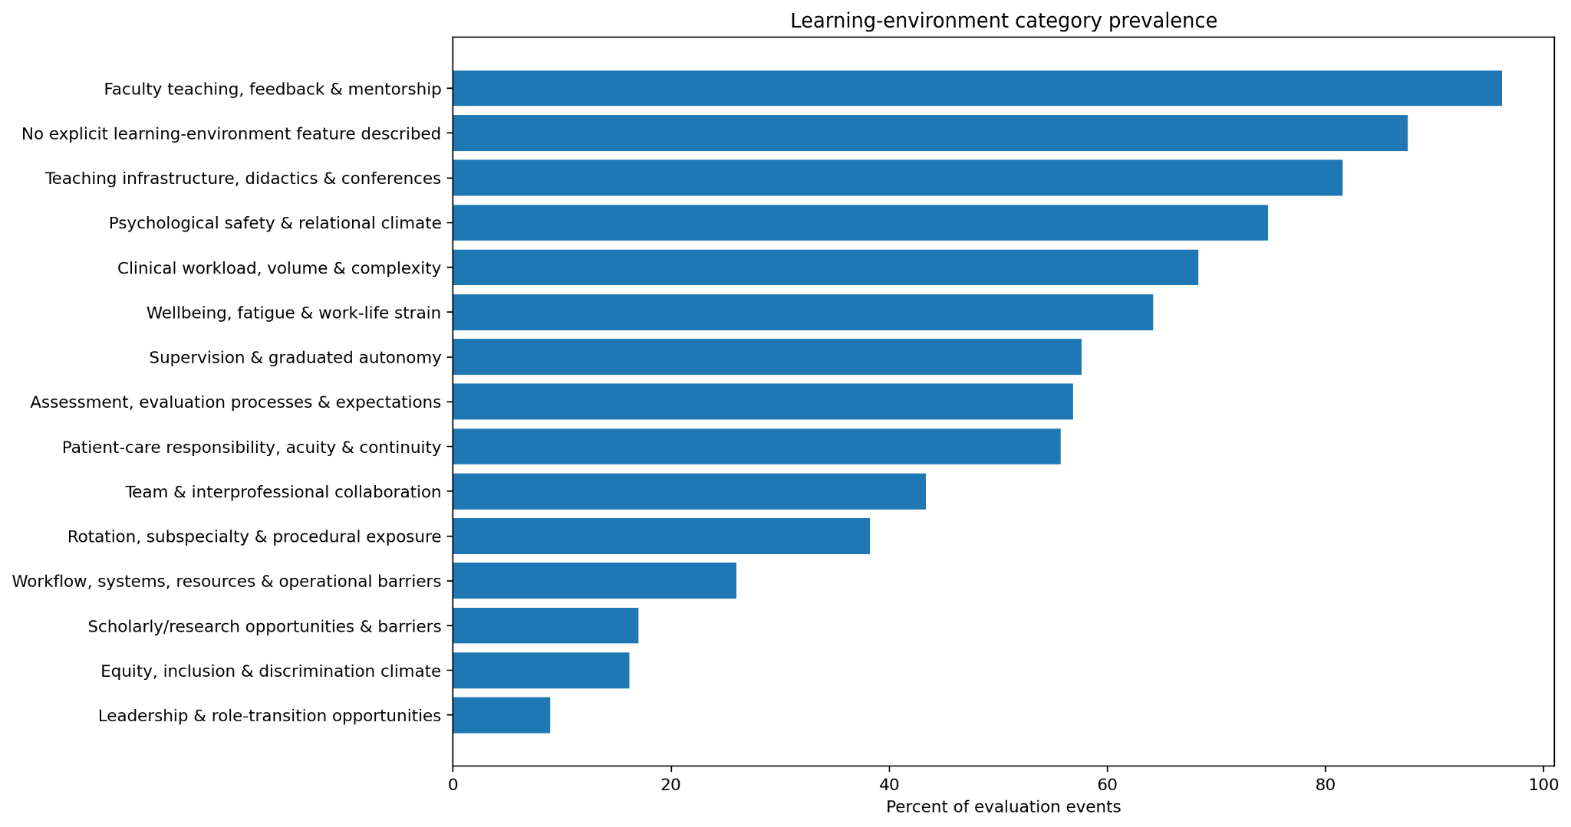
Learning-environment prevalence
What features of the learning environment are most often present in evaluation narratives?
Key message: Faculty teaching/feedback/mentorship is nearly universal, while psychological safety, teaching infrastructure, workload, wellbeing, supervision, and assessment also appear frequently.
INPUT
OUTPUT
HOW TO INTERPRET
All evaluation events with coded learning-environment labels.
Percent of evaluation events containing each environment category.
Longer bars mean the category is mentioned in more events. Multiple labels can occur in one event.
Notes:
Faculty teaching, feedback, and mentorship is the dominant learning-environment feature, followed by teaching infrastructure and psychological safety. Workload, wellbeing, supervision, and assessment also occur in a large share of events. A major caveat is that “No explicit learning-environment feature described” is also extremely common, which is logically difficult to reconcile with the high prevalence of explicit features and should be audited as a coding-rule problem.

Slide 5
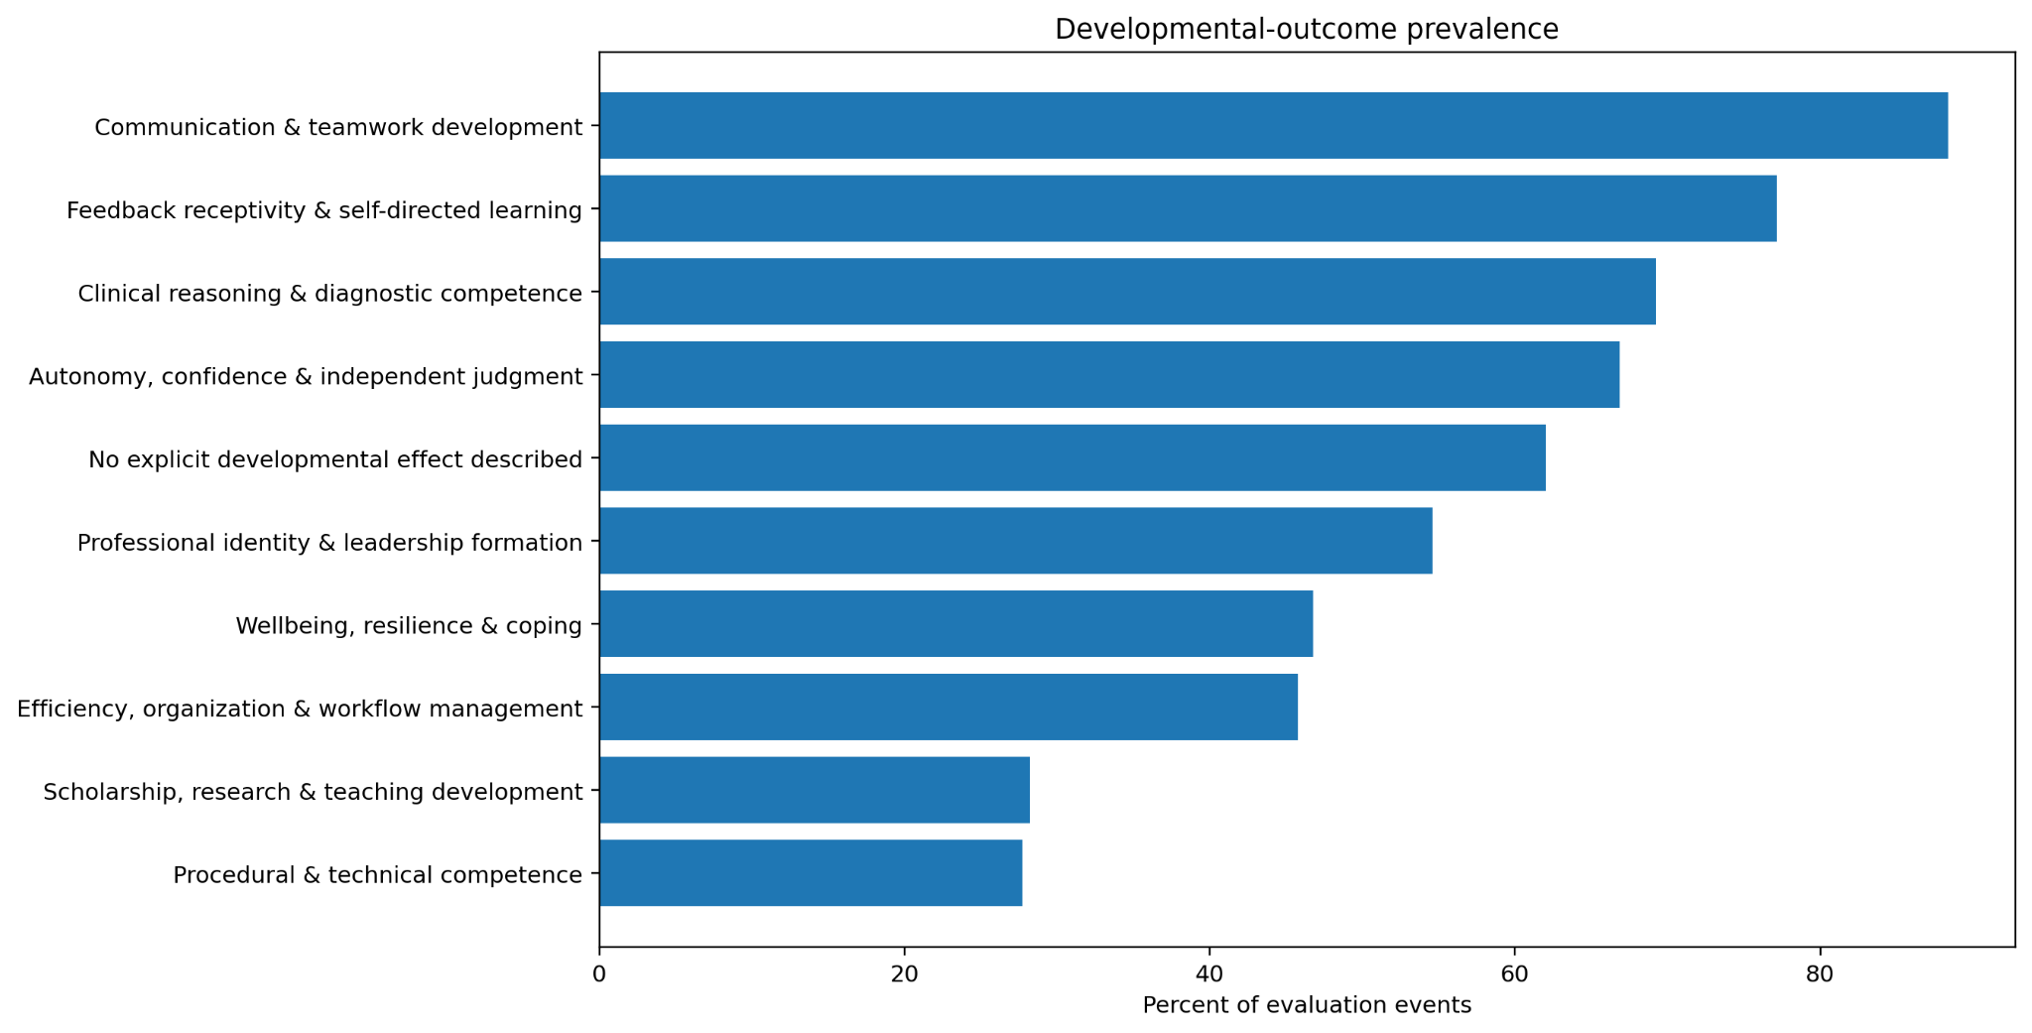
Developmental-outcome prevalence
What kinds of trainee development are described in the narratives?
Key message: The narratives emphasize communication/teamwork, feedback receptivity, clinical reasoning, and autonomy more than scholarship or procedural/technical development.
INPUT
OUTPUT
HOW TO INTERPRET
Evaluation events with developmental-outcome codes.
Percent of events containing each developmental outcome.
This is the developmental content being described—not necessarily a causal effect of the environment.
Notes:
Communication and teamwork development is the most common developmental outcome, followed by feedback receptivity and self-directed learning, clinical reasoning, and autonomy/confidence. This suggests that the evaluation system captures relational, reflective, and reasoning-oriented development at least as strongly as technical competence. The “No explicit developmental effect” label remains common and should be interpreted as an absence of clear developmental language in many events.

Slide 6
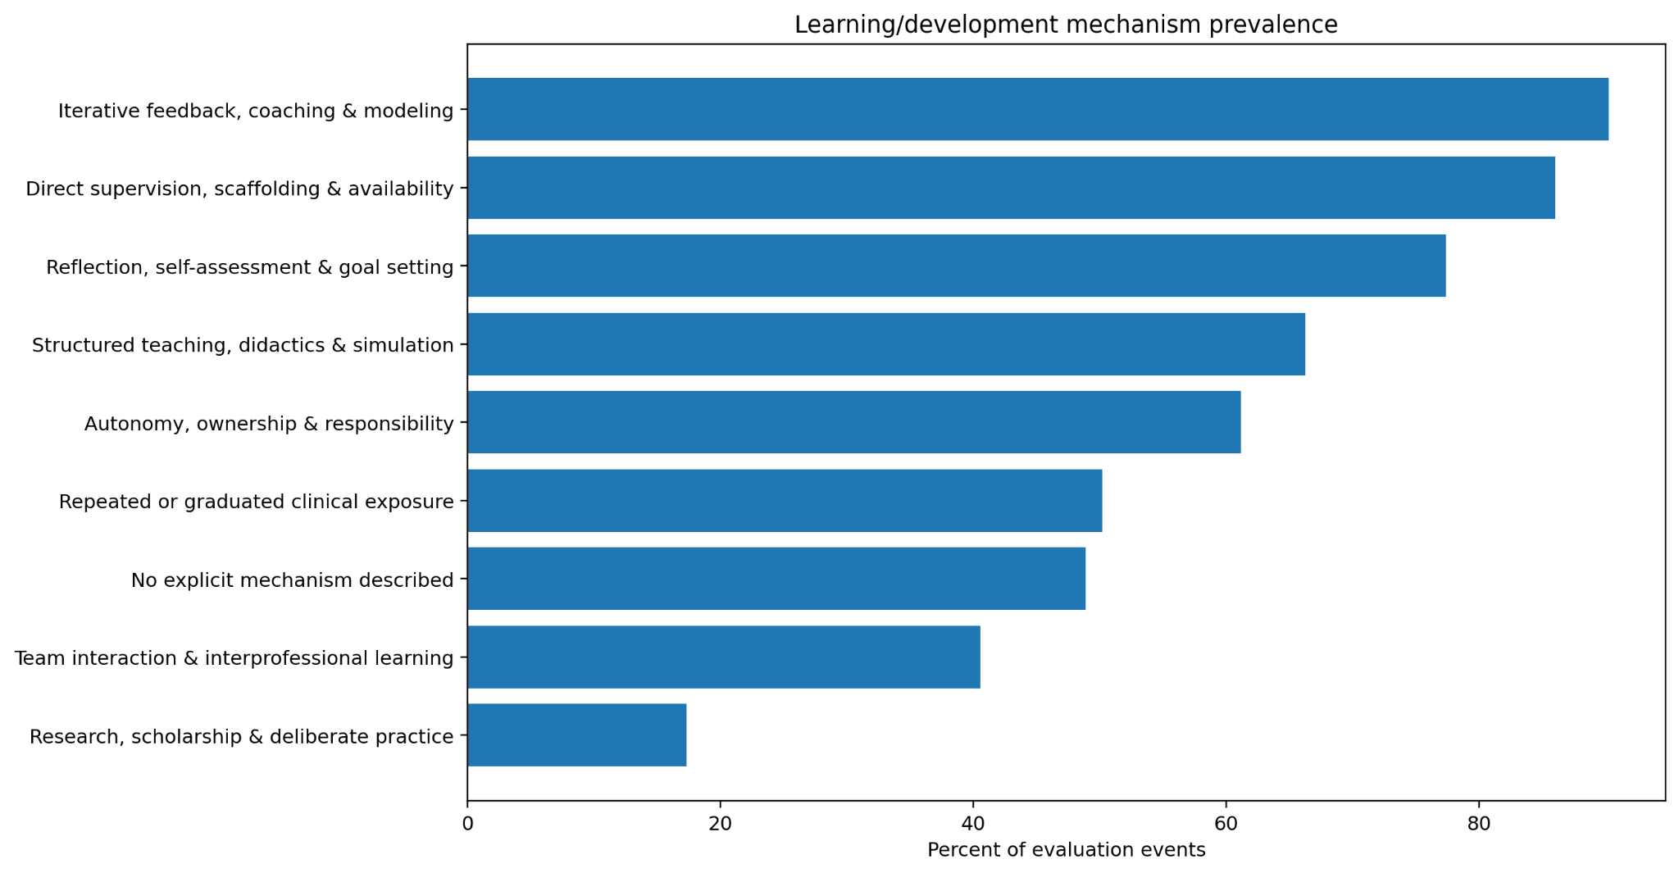
Learning and development mechanisms
How is learning described as happening?
Key message: Feedback/coaching and direct supervision are the dominant mechanisms, with reflection, structured teaching, autonomy, and repeated clinical exposure forming the next layer.
INPUT
OUTPUT
HOW TO INTERPRET
Evaluation events with mechanism codes.
Percent of events in which each learning mechanism is present.
This chart describes the process of learning—the “how”—rather than the outcome.
Notes:
The strongest mechanisms are iterative feedback, coaching and modeling, followed by direct supervision, scaffolding and availability. Reflection and goal setting are also common. Together, these results suggest a feedback-rich and supervision-dependent model of learning, with autonomy and repeated clinical exposure functioning as additional mechanisms.

Slide 7
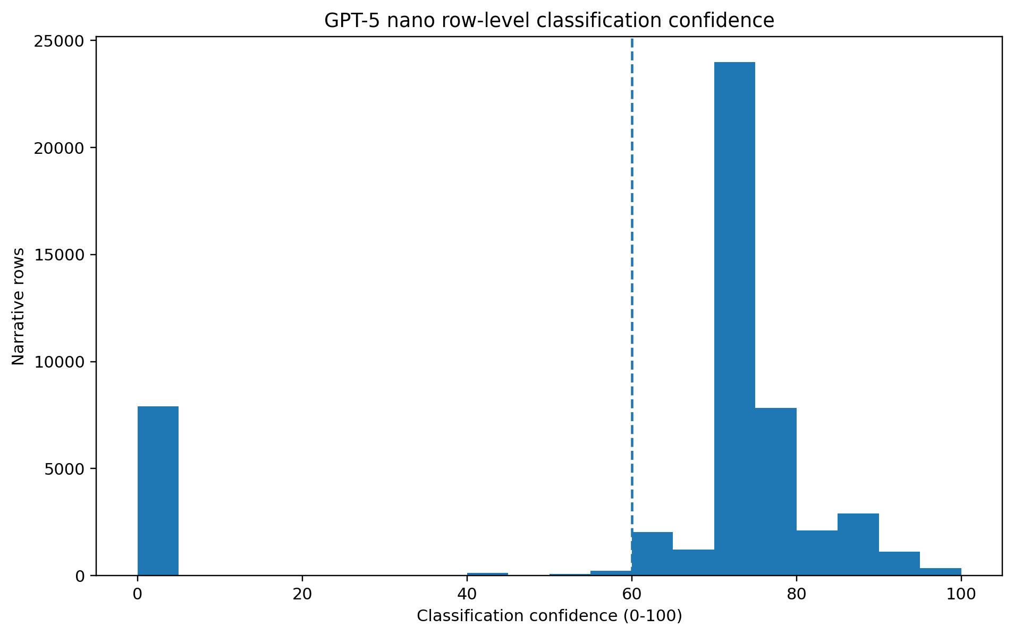
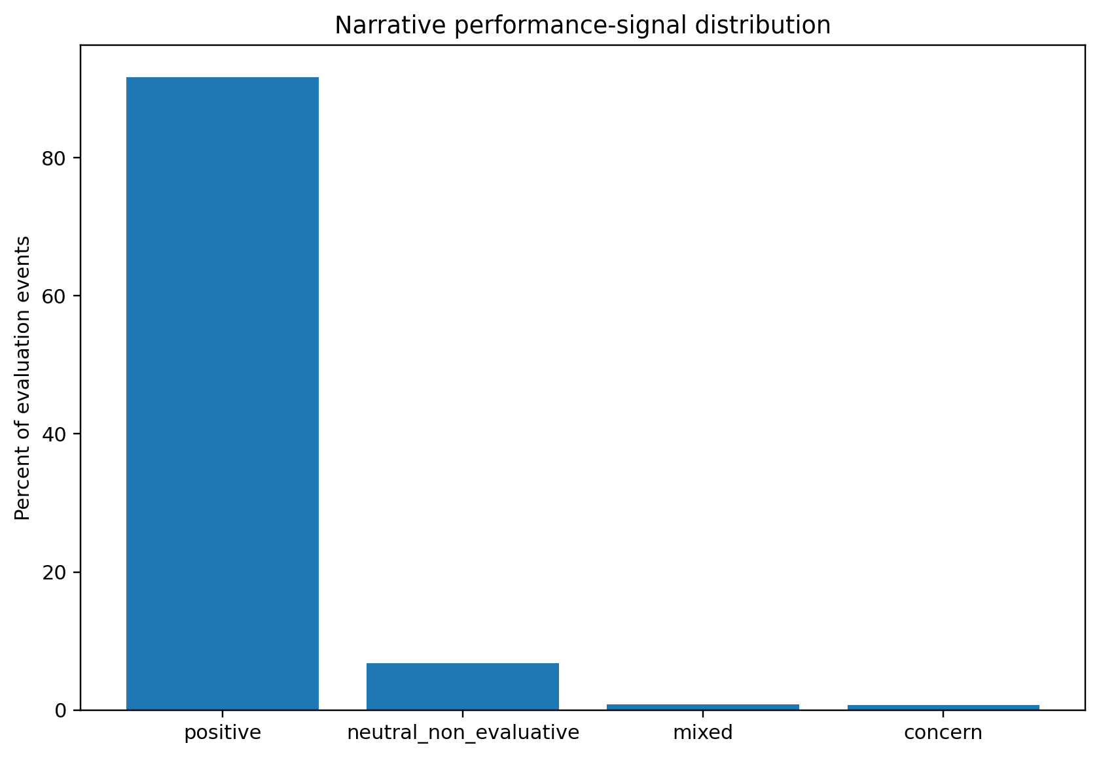
Model confidence and performance-signal distribution
Two checks on the behavior of the row-level classifier
Key message: Most scored rows cluster above the 60-point confidence threshold, but there is a distinct spike at zero. Performance signals are overwhelmingly positive, which creates severe class imbalance.
INPUT
OUTPUT
HOW TO INTERPRET
Row-level classification outputs and confidence scores.
Confidence distribution plus event-level performance-signal proportions.
High confidence supports stable coding; zero/low-confidence rows and rare concern classes need targeted human validation.
Notes:
The classifier confidence distribution is concentrated around the 70–80 range, above the visual threshold at 60, but the spike at zero needs separate investigation. It may reflect missing confidence assignments, skipped content, or genuine uncertainty. The performance signal is overwhelmingly positive; neutral, mixed, and concern classes are rare. That may reflect the source data, but it also means that accuracy alone would be misleading for validation. Precision, recall, and targeted review of minority classes are more informative.

Slide 8
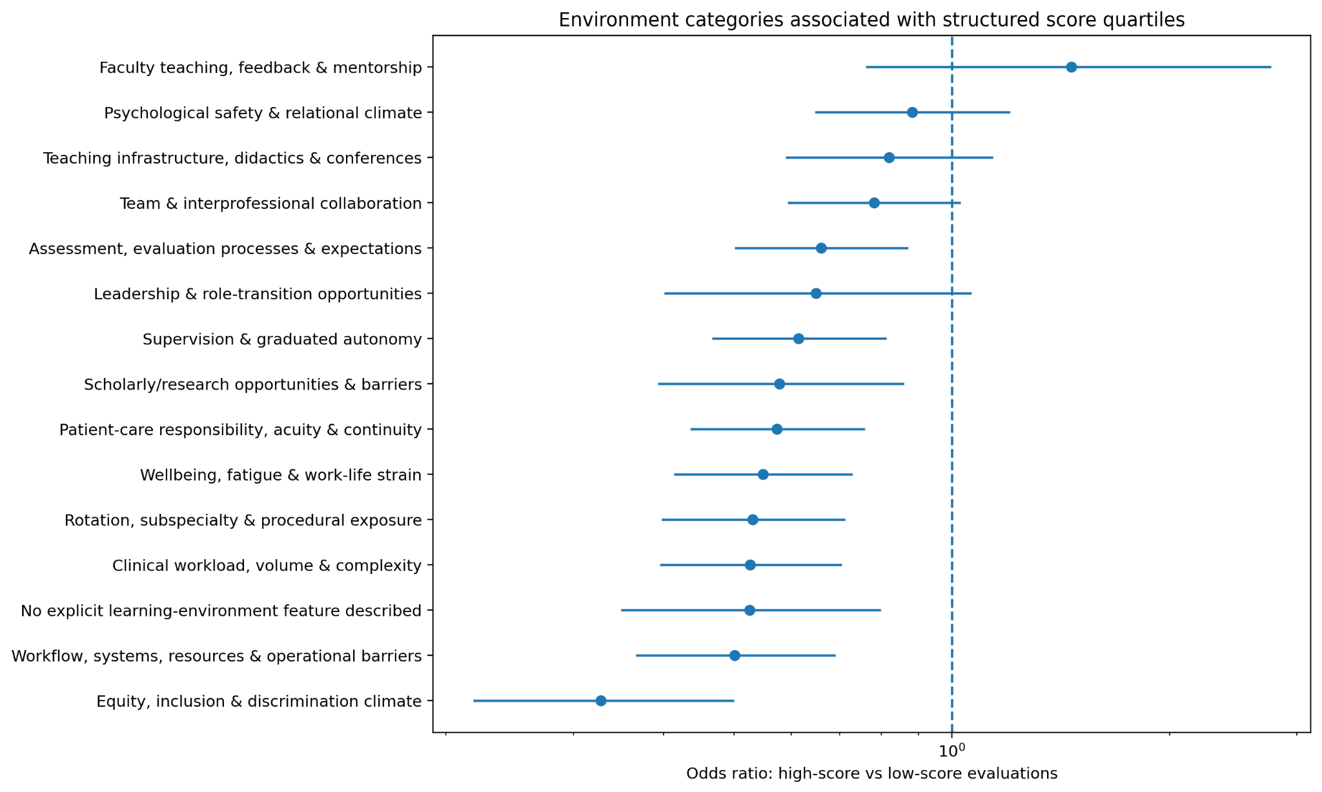
Environment categories associated with structured-score quartiles
Odds ratio: presence in high-score evaluations versus low-score evaluations
Key message: Several environment categories are enriched in low-score evaluations, especially equity/discrimination climate, workflow barriers, workload/complexity, wellbeing strain, and “no explicit feature.”
INPUT
OUTPUT
HOW TO INTERPRET
Evaluation events split into higher- versus lower-structured-score groups.
Odds ratios with uncertainty intervals for each environment category.
OR > 1 means the label is more common in high-score events; OR < 1 means it is more common in low-score events. If the interval crosses 1, the difference is uncertain.
Notes:
The vertical reference line is an odds ratio of 1, meaning no difference between high- and low-score events. Many categories sit below 1, indicating that they occur more often in lower-score evaluations. The strongest negative association is seen for equity, inclusion and discrimination climate. Workflow barriers, clinical workload, wellbeing strain, and several other categories also appear more frequently in low-score evaluations. Faculty teaching, feedback and mentorship is the only point estimate above 1, but its interval appears to cross 1, so the evidence for a high-score association is not definitive. These are associations, not causal effects.

Slide 9
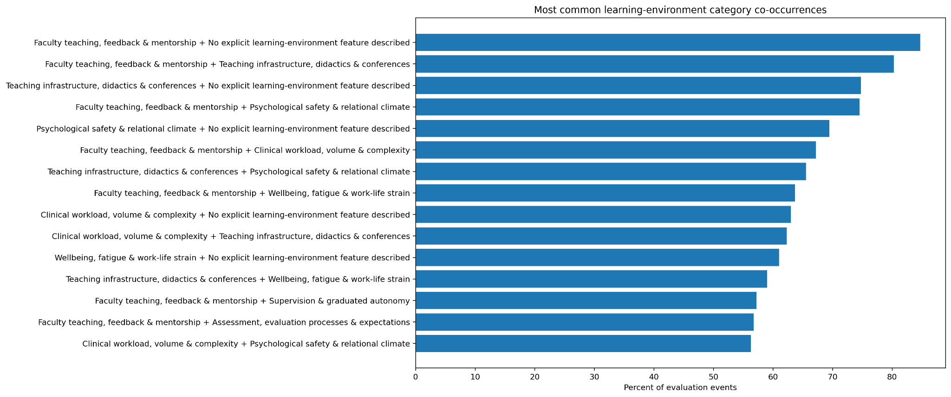
Learning-environment category co-occurrence
Which environment features tend to be mentioned together?
Key message: The learning environment is multi-factorial: feedback/mentorship, teaching infrastructure, psychological safety, workload, wellbeing, and supervision frequently appear in the same events.
INPUT
OUTPUT
HOW TO INTERPRET
Pairs of environment labels within the same evaluation event.
Percent of events in which each pair co-occurs.
High co-occurrence means the two themes often travel together; it does not establish which theme drives the other.
Notes:
The strongest meaningful co-occurrences involve faculty teaching and feedback with teaching infrastructure, psychological safety, workload, wellbeing, supervision, and assessment. This supports an ecosystem interpretation rather than isolated themes. However, the most frequent pair includes “No explicit learning-environment feature described” alongside an explicit feature, which should not happen under a clean mutually exclusive rule. That is a major taxonomy-logic issue to fix before using co-occurrence as a substantive finding.

Slide 10
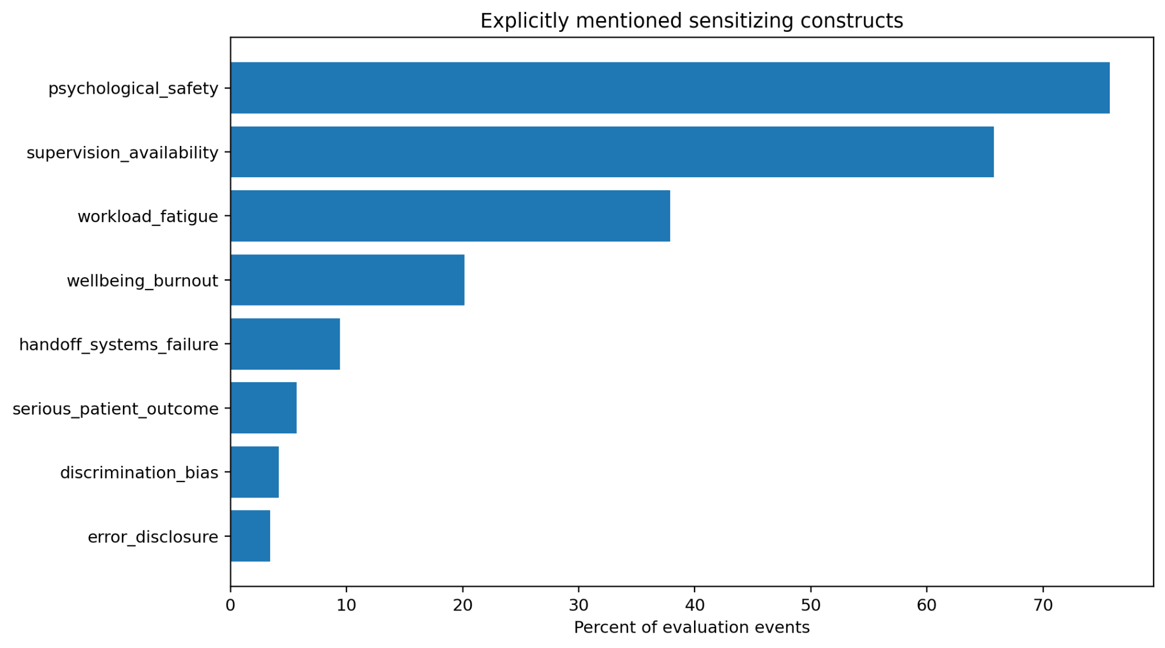
Explicit sensitizing constructs
Which higher-level concepts are directly visible in the narratives?
Key message: Psychological safety and supervision availability dominate explicit constructs; workload/fatigue and wellbeing/burnout form a second tier.
INPUT
OUTPUT
HOW TO INTERPRET
Evaluation events searched for explicitly named sensitizing constructs.
Percent of evaluation events in which each construct is explicitly mentioned.
Higher prevalence shows what the narratives most often surface explicitly; low prevalence does not imply low importance.
Notes:
Psychological safety is the most prominent sensitizing construct, followed by supervision availability. Workload/fatigue and wellbeing/burnout are also common. Handoff failures, serious patient outcomes, discrimination/bias, and error disclosure are much rarer. Those rare constructs may still be critically important, so they should be analyzed with event counts and qualitative review rather than dismissed because of low prevalence.

Slide 11
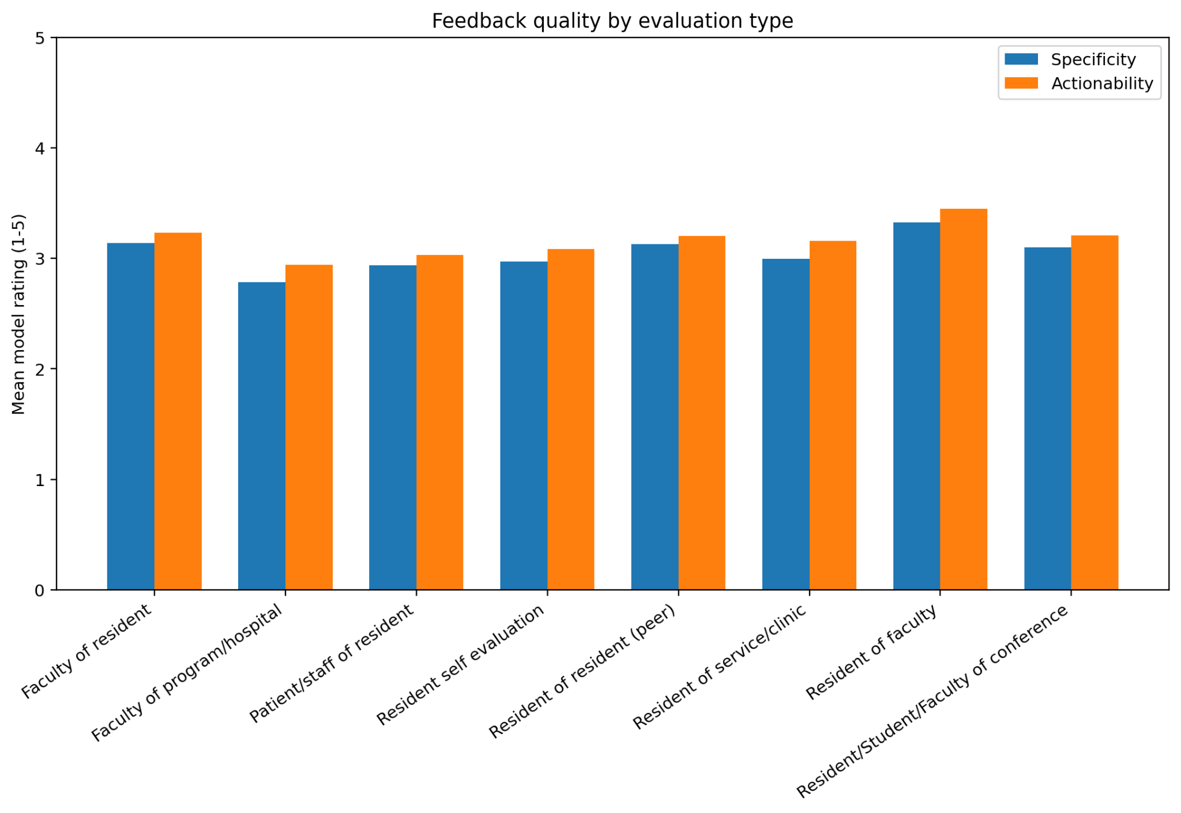
Feedback quality by evaluation type
Model-rated specificity and actionability on a 1–5 scale
Key message: Feedback quality is moderate across all evaluation types. Actionability is consistently slightly higher than specificity, and “resident of faculty” feedback scores highest.
INPUT
OUTPUT
HOW TO INTERPRET
Narrative feedback grouped by evaluation type.
Mean model ratings for specificity and actionability.
Scores near 3 indicate usable but only moderately detailed feedback; the differences across evaluation types are small but operationally useful.
Notes:
Most feedback-quality averages fall around 2.8 to 3.4 out of 5. Actionability is slightly higher than specificity in every evaluation type. Resident evaluations of faculty appear to have the highest mean ratings, while faculty evaluations of the program or hospital are the lowest. This suggests an opportunity to improve concrete detail and next-step guidance, particularly in the weaker evaluation channels.

Slide 12
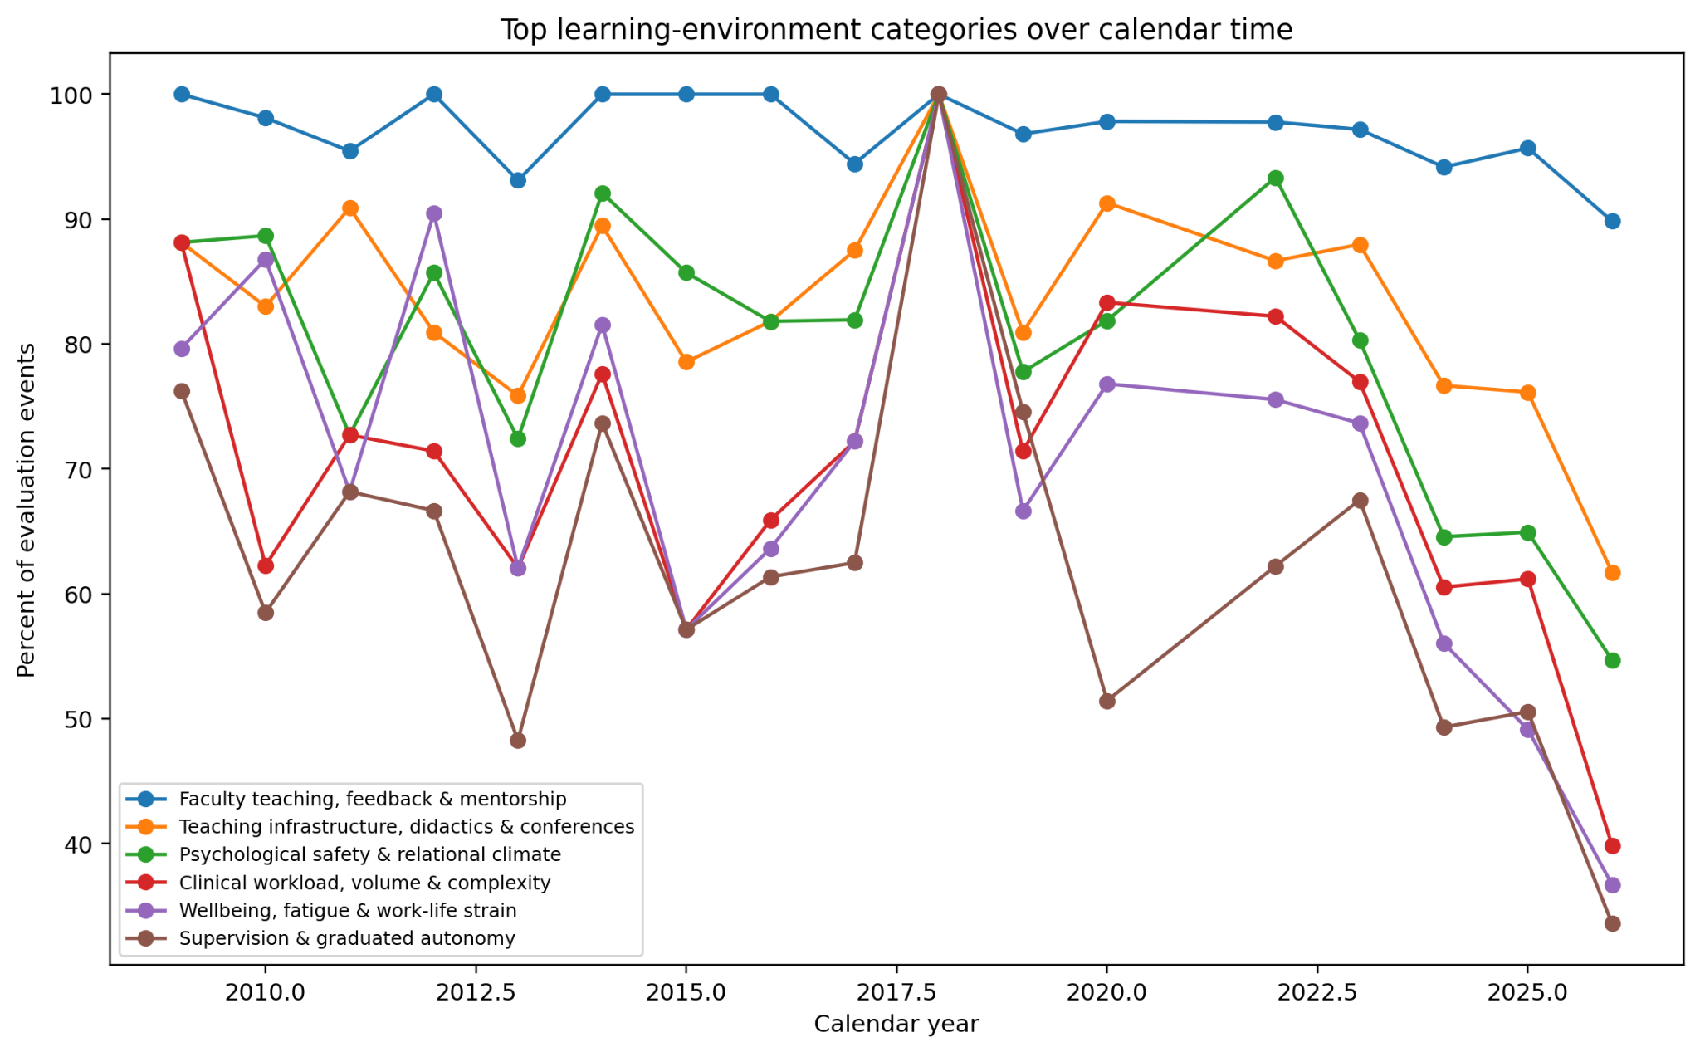
Learning-environment categories over calendar time
Descriptive annual prevalence of the most common environment themes
Key message: Faculty teaching/feedback remains consistently high, while the other major categories fluctuate substantially and appear lower in the most recent years.
INPUT
OUTPUT
HOW TO INTERPRET
Evaluation events grouped by calendar year.
Annual percentage of events containing each top environment category.
Treat this as descriptive only until yearly denominators, evaluation mix, and program composition are controlled.
Notes:
Faculty teaching, feedback and mentorship stays very high across the timeline. Teaching infrastructure, psychological safety, workload, wellbeing, and supervision fluctuate more strongly. Several categories appear to decline in the latest years. That pattern could reflect a real change, but it could also be driven by changes in the number or type of evaluations, specialties, programs, or data coverage. A formal trend analysis should therefore use event counts and adjusted models rather than the raw percentages alone.

Slide 13
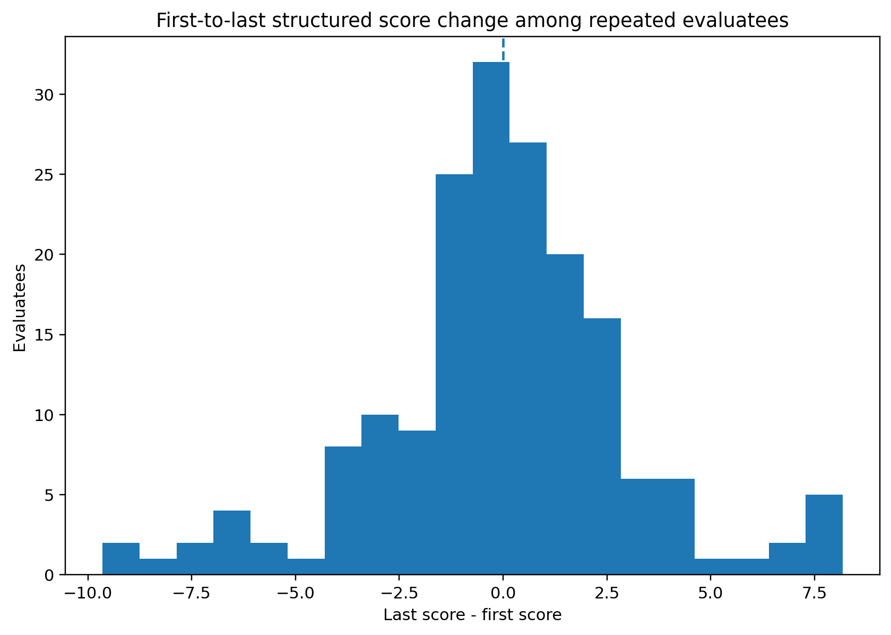
First-to-last structured-score change among repeated evaluatees
A simple longitudinal view of individuals with repeated observations
Key message: Changes cluster near zero, with both meaningful gains and declines. There is no obvious system-wide directional improvement from this first-versus-last comparison alone.
INPUT
OUTPUT
HOW TO INTERPRET
Evaluatees with at least two structured-score observations.
Distribution of last score minus first score.
Values above zero are improvement; below zero are decline. A distribution centered near zero suggests little net shift at the group level.
Notes:
The first-to-last difference distribution is concentrated around zero and extends in both directions. Some evaluatees improve substantially and others decline, but the overall distribution does not show a strong uniform shift. Because this comparison ignores the number and timing of observations and the context of each evaluation, the preferred next step is a longitudinal mixed-effects model rather than relying on first-versus-last change alone.

Slide 14
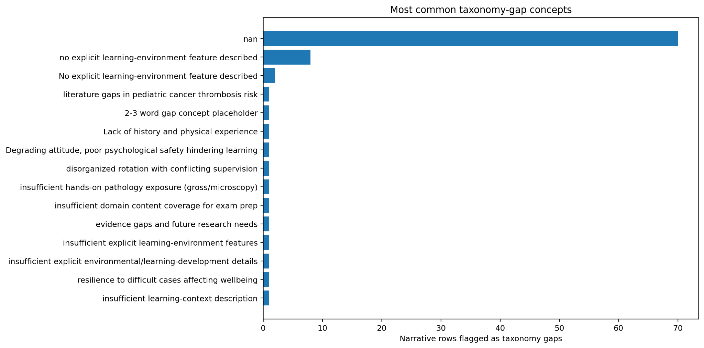
Taxonomy gaps and data-quality signals
What the classifier could not cleanly map to the current taxonomy
Key message: Meaningful taxonomy gaps appear rare; however, the gap list is dominated by missing values and duplicate “no explicit feature” labels, so the gap pipeline needs cleaning before taxonomy expansion.
INPUT
OUTPUT
HOW TO INTERPRET
Rows flagged as taxonomy gaps by the coding pipeline.
Counts of the most common gap concepts.
True novel concepts should appear as interpretable themes. “NaN,” placeholders, and duplicates are pipeline-cleaning issues rather than conceptual gaps.
Notes:
The chart is dominated by NaN values, followed by duplicate variants of “no explicit learning-environment feature described.” The genuinely novel concepts occur only a few times each. This suggests that the existing taxonomy is broadly comprehensive, but the gap-extraction logic needs housekeeping so that missing fields and placeholders are not treated as conceptual discoveries.

Slide 15
Integrated interpretation: the dominant learning pathway
A synthesis across environment, mechanism, and developmental outcomes
Key message: The strongest cross-chart story is a feedback-rich learning ecosystem: supportive faculty and psychologically safe supervision enable coaching, reflection, and structured teaching, which are linked descriptively to communication, reasoning, feedback receptivity, and autonomy.
LEARNING ENVIRONMENT
MECHANISMS
DEVELOPMENTAL OUTCOMES
Faculty teaching / mentorship
Iterative feedback / coaching
Communication / teamwork
Teaching infrastructure
Direct supervision / scaffolding
Feedback receptivity
Psychological safety
Reflection / self-assessment
Clinical reasoning
Supervision / autonomy
Structured teaching
Autonomy / confidence
Workload & wellbeing context
Repeated clinical exposure
Professional identity
IMPORTANT CAVEAT
This integrated pathway is a synthesis of descriptive prevalence and association patterns. It should be treated as a working conceptual model to test—not as a proven causal pathway.
Notes:
Taken together, the charts suggest a coherent conceptual model. The dominant environment is one with active faculty teaching, feedback, psychologically safe relationships, and available supervision. The dominant mechanisms are coaching, scaffolding, reflection, and structured teaching. The dominant developmental outcomes are communication, feedback receptivity, reasoning, and autonomy. This is a strong hypothesis-generating pattern, but it still requires validation and causal or longitudinal analysis.

Slide 16
Key takeaways
What I would communicate to the GMETS team
Feedback is the central educational engine
Psychological safety is not peripheral
Teaching, feedback, mentorship, coaching, and supervision are the most consistent signals across the corpus.
It is one of the most prevalent environment features and the most common explicit sensitizing construct.
Development is multi-dimensional
Low scores are associated with friction and strain
Communication, self-directed learning, reasoning, autonomy, and identity formation are at least as visible as technical competence.
Workflow barriers, workload/complexity, wellbeing strain, equity/discrimination climate, and several related labels occur more often in low-score evaluations.
The evaluation language is strongly positive
The taxonomy is useful but not yet analytically clean
Concern and mixed signals are rare, so minority-class validation and imbalance-aware modeling are necessary.
“No explicit” labels, missing gap values, and duplicates need rule-based cleanup before publication-grade inference.
Notes:
These are the main messages that can be defended from the descriptive outputs. The most important substantive finding is the centrality of feedback, supervision, and psychological safety. The most important methodological finding is that the coding taxonomy needs a small amount of rule cleanup and human validation before stronger claims are made.

Slide 17
Action items and next analysis steps
How to move from descriptive discovery to decision-ready evidence
1. Fix and validate the coding layer
2. Strengthen the statistical analysis
3. Turn findings into improvement work
1
Make “no explicit feature” mutually exclusive with explicit environment labels.
1
Use multivariable mixed-effects models for score associations.
1
Prioritize feedback specificity and actionability in weaker evaluation channels.
2
Clean NaN / placeholder / duplicate taxonomy-gap outputs.
2
Adjust for year, evaluation type, program/specialty, evaluator/evaluatee, and repeated observations.
2
Track psychological safety, supervision availability, workload, and wellbeing as program indicators.
3
Human-audit a stratified sample, oversampling zero-confidence and concern/mixed rows.
3
Model longitudinal trajectories instead of only first-versus-last change.
3
Investigate low-score-enriched themes by program and specialty.
4
Report precision, recall, F1, and agreement—not accuracy alone.
4
Add yearly denominators and uncertainty intervals to time trends.
4
Build a dashboard that links narrative themes, structured scores, and longitudinal change.
Recommended priority: validate taxonomy + confidence first, then run adjusted mixed-effects models, then operationalize the strongest themes in a GMETS dashboard.
Notes:
The next step should not be another descriptive chart. First clean the taxonomy rules and create a human validation set. Then run adjusted mixed-effects models that respect repeated observations and program context. Once the associations are stable, convert the strongest and most actionable themes—feedback quality, psychological safety, supervision, workload, and wellbeing—into recurring program indicators and targeted improvement work.

